Slide 1

Backward Propagation
Professor Bo Liu
James Watt School of Engineering

Slide 2

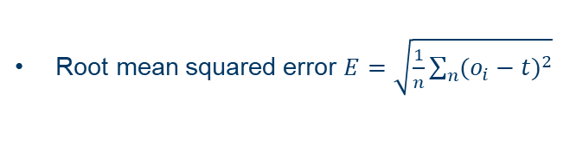

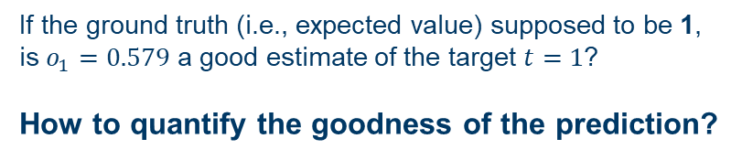


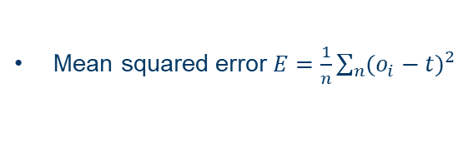



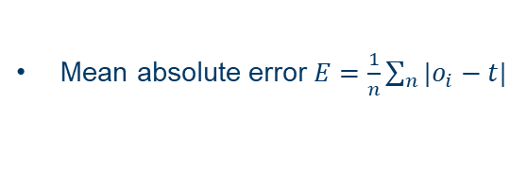
Loss function
Weight $w_{1}=0.25$
Input to the neuron $i_{1}=0.8$
Output : $o_{1}=0.579$
Bias $b_{1}=0.12$
If the ground truth (i.e., expected value) supposed to be 1,
is $o_{1}=0.579$ a good estimate of the target $t=1$?
How to quantify the goodness of the prediction?
Mean absolute error $E=\frac{1}{n}\sum_{n}{|o_{i}−t|}$
Loss: The lower the better
$$E=\left|0.579−1\right|=0.421$$
Loss functions are sometimes called:
Error function.
Cost function.
Loss.
Mean squared error $E=\frac{1}{n}\sum_{n}{{(o_{i}−t)}^{2}}$
$$E{=(0.579−1)}^{2} =0.1772$$
Root mean squared error $E=\sqrt{\frac{1}{n}\sum_{n}{{(o_{i}−t)}^{2}}}$
$$E=\sqrt{{(0.579−1)}^{2}}=0.421$$

Slide 3
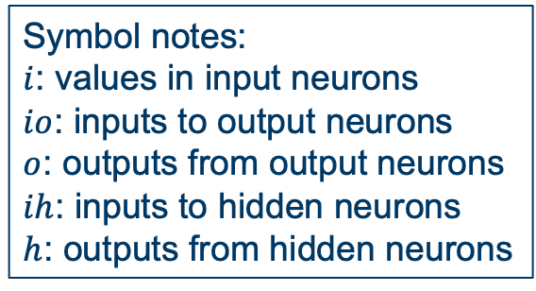
The network example
Input: [0.35, 0.9]
Expected output: [0.5]
Activation function: Sigmoid
Input layer
Hidden layer
Output layer
$$i_{1}$$
$$h_{1}$$
$$w_{1}$$
Input 1
0.35
0.1
$$w_{5}$$
$$w_{2}$$
0.3
$$o_{1}$$
0.4
$$w_{3}$$
Output
$$i_{2}$$
0.8
$$h_{2}$$
Symbol notes:
$i$: values in input neurons
$io$: inputs to output neurons
$o$: outputs from output neurons
$ih$: inputs to hidden neurons
$h$: outputs from hidden neurons
Input 2
$$w_{4}$$
$$w_{6}$$
0.9
0.9
0.6

Slide 4
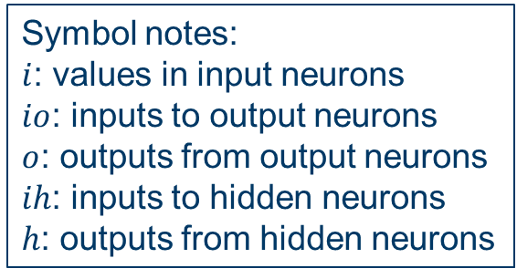
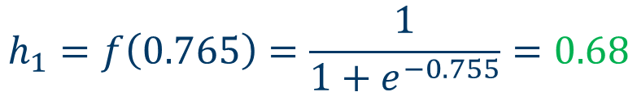
Forward propagation
Input: [0.35, 0.9]
Expected output: [0.5]
Activation function: Sigmoid
$${ih}_{1}0.35×0.1+0.9×0.8=0.755$$
$$h_{1}=f\left(0.765\right)=\frac{1}{1+e^{−0.755}}=0.68$$
Input layer
Hidden layer
Output layer
$$i_{1}$$
$$h_{1}$$
$$w_{1}$$
Input 1
0.35
0.1
0.68
$$w_{5}$$
$$w_{2}$$
0.3
$$o_{1}$$
0.4
$$w_{3}$$
Output
$$i_{2}$$
0.8
$$h_{2}$$
Symbol notes:
$i$: values in input neurons
$io$: inputs to output neurons
$o$: outputs from output neurons
$ih$: inputs to hidden neurons
$h$: outputs from hidden neurons
Input 2
$$w_{4}$$
$$w_{6}$$
0.9
0.9
0.6

Slide 5
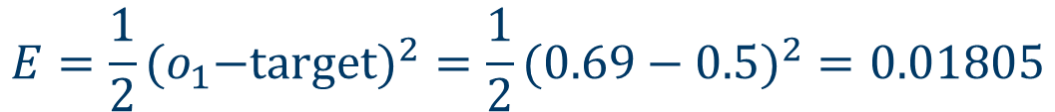
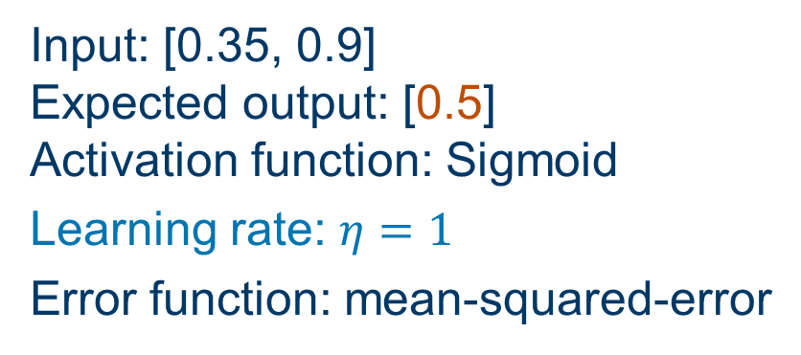

Forward and backward propagation
Note: here, half-mean-squared-error loss function is used. The 1/2 is included so that exponent is cancelled when it is differentiated later.
Input: [0.35, 0.9]
Expected output: [0.5]
Activation function: Sigmoid
Learning rate: $η=1$
Error function: mean-squared-error
How to update $w$ to get lower loss?
Gradient descent.
Input layer
Hidden layer
Output layer
$$i_{1}$$
$$h_{1}$$
$$w_{1}$$
Input 1
0.35
0.1
0.68
$$w_{5}$$
$$w_{2}$$
0.3
$$o_{1}$$
0.4
$$w_{3}$$
0.69
Output
$$i_{2}$$
0.8
$$h_{2}$$
Symbol notes:
$i$: values in input neurons
$io$: inputs to output neurons
$o$: outputs from output neurons
$ih$: inputs to hidden neurons
$h$: outputs from hidden neurons
Input 2
$$w_{4}$$
$$w_{6}$$
0.9
0.6637
0.9
0.6
$${E=\frac{1}{2}{{(o}_{1}−target)}^{2}=\frac{1}{2}(0.69−0.5)}^{2}=0.01805$$

Slide 6
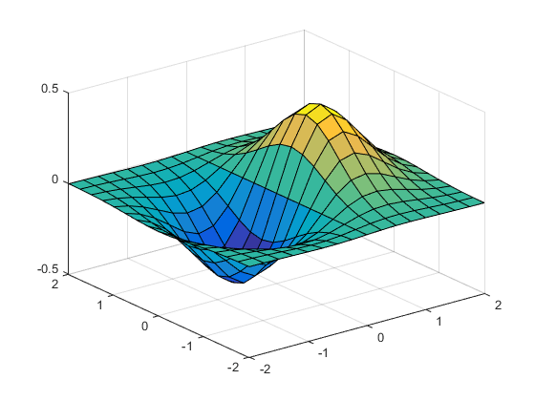
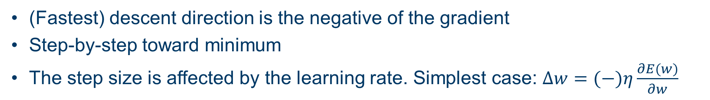
Gradient descent algorithm
(Fastest) descent direction is the negative of the gradient
Step-by-step toward minimum
The step size is affected by the learning rate. Simplest case: $∆w=(−)η\frac{∂E(w)}{∂w}$

Slide 7
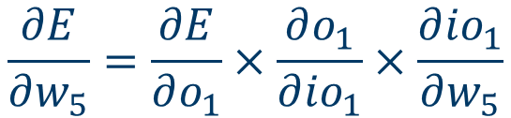
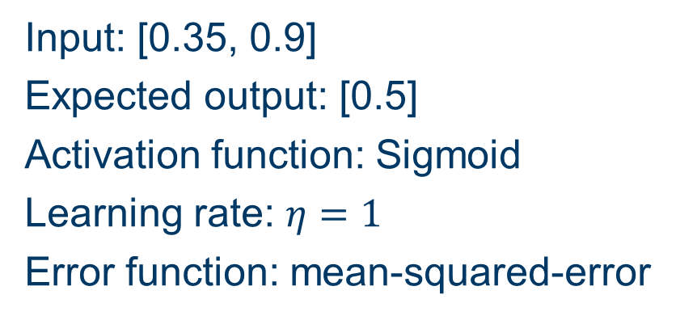
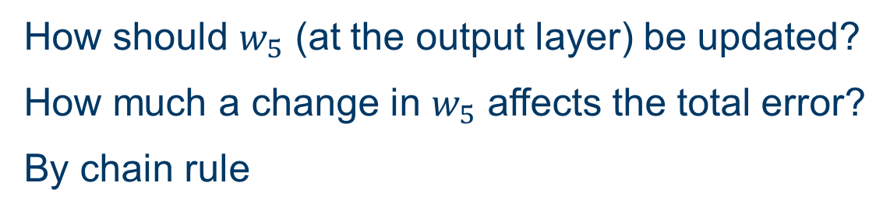

Backward propagation
Input: [0.35, 0.9]
Expected output: [0.5]
Activation function: Sigmoid
Learning rate: $η=1$
Error function: mean-squared-error
How should $w_{5}$ (at the output layer) be updated?
How much a change in $w_{5}$ affects the total error?
By chain rule
$$\frac{∂E}{∂w_{5}}=\frac{∂E}{∂o_{1}}×\frac{∂o_{1}}{∂{io}_{1}}×\frac{∂{io}_{1}}{∂w_{5}}$$
Input layer
Hidden layer
Output layer
$$i_{1}$$
$$h_{1}$$
$$w_{1}$$
Input 1
0.35
0.1
0.68
$$w_{5}$$
$$w_{2}$$
0.3
$$o_{1}$$
0.4
Symbol notes:
$i$: values in input neurons
$io$: inputs to output neurons
$o$: outputs from output neurons
$ih$: inputs to hidden neurons
$h$: outputs from hidden neurons
$$w_{3}$$
0.69
Output
$$i_{2}$$
0.8
$$h_{2}$$
Input 2
$$w_{4}$$
$$w_{6}$$
0.9
0.6637
0.9
0.6

Slide 8



Backward propagation
Input: [0.35, 0.9]
Expected output: [0.5]
Activation function: Sigmoid
Learning rate: $η=1$
Error function: mean-squared-error
$$\frac{∂E}{∂o_{1}}=\frac{{{∂(o}_{1}−target)}^{2}/2}{∂o_{1}}=o_{1}−target=0.19$$
$$\frac{∂o_{1}}{∂{io}_{1}}=\frac{∂(1/(1+e^{−{io}_{1}}))}{∂{io}_{1}}=o_{1}\left({1−o}_{1}\right)=0.69\left(1−0.69\right)=0.2139$$
$$\frac{∂{io}_{1}}{∂w_{5}}=\frac{∂(h_{1}w_{5}+h_{2}w_{6})}{{∂w}_{5}}=h_{1}=0.68$$
Input layer
Hidden layer
Output layer
$$i_{1}$$
$$h_{1}$$
$$w_{1}$$
Input 1
0.35
0.1
0.68
$$w_{5}$$
$$w_{2}$$
0.2724
$$o_{1}$$
0.4
$$w_{3}$$
0.69
Output
$$i_{2}$$
0.8
$$h_{2}$$
Input 2
$$w_{4}$$
$$w_{6}$$
$$∆w_{5}=η\frac{∂E}{∂w_{5}}=1×0.19×0.2139×0.68=0.0276$$
0.9
0.6637
0.9
0.6
$$updated w_{5}=w_{5}−∆w_{5}=0.3−0.0276=0.2724$$

Slide 9


Backward propagation
Input: [0.35, 0.9]
Expected output: [0.5]
Activation function: Sigmoid
Learning rate: $η=1$
Error function: mean-squared-error
Input layer
Hidden layer
Output layer
$$i_{1}$$
$$h_{1}$$
$$w_{1}$$
Input 1
0.35
0.1
0.68
$$w_{5}$$
$$w_{2}$$
0.2724
$$o_{1}$$
0.4
Symbol notes:
$i$: values in input neurons
$io$: inputs to output neurons
$o$: outputs from output neurons
$ih$: inputs to hidden neurons
$h$: outputs from hidden neurons
$$w_{3}$$
0.69
Output
$$i_{2}$$
0.8
$$h_{2}$$
Input 2
$$w_{4}$$
$$w_{6}$$
0.9
0.6637
0.8731
0.6
Similarly, for $w_{6}$

Slide 10
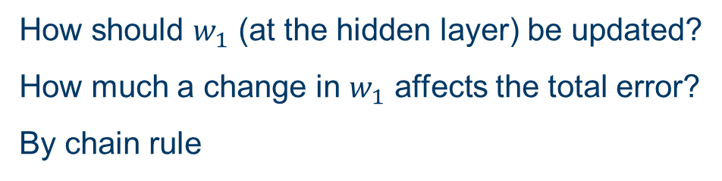
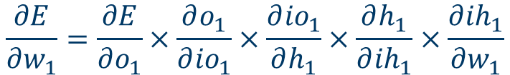
Backward propagation
Input: [0.35, 0.9]
Expected output: [0.5]
Activation function: Sigmoid
Learning rate: $η=1$
Error function: mean-squared-error
How should $w_{1}$ (at the hidden layer) be updated?
How much a change in $w_{1}$ affects the total error?
By chain rule
$$\frac{∂E}{∂w_{1}}=\frac{∂E}{∂o_{1}}×\frac{∂o_{1}}{∂{io}_{1}}×\frac{∂{io}_{1}}{∂h_{1}}×\frac{∂h_{1}}{∂{ih}_{1}}×\frac{∂{ih}_{1}}{∂w_{1}}$$
Input layer
Hidden layer
Output layer
$$i_{1}$$
$$h_{1}$$
$$w_{1}$$
Input 1
0.35
0.1
0.68
$$w_{5}$$
$$w_{2}$$
0.2724
$$o_{1}$$
0.4
Symbol notes:
$i$: values in input neurons
$io$: inputs to output neurons
$o$: outputs from output neurons
$ih$: inputs to hidden neurons
$h$: outputs from hidden neurons
$$w_{3}$$
0.69
Output
$$i_{2}$$
0.8
$$h_{2}$$
Input 2
$$w_{4}$$
$$w_{6}$$
0.9
0.6637
0.8731
0.6

Slide 11
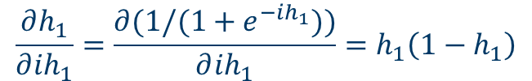
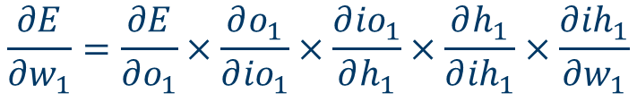





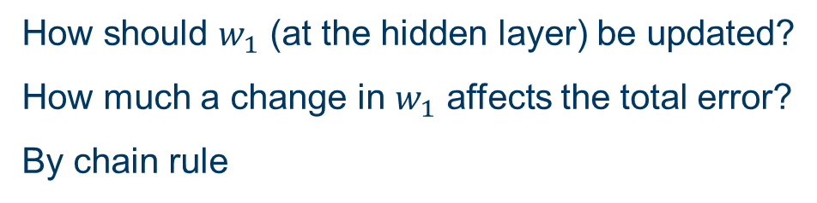

Backward propagation
Input: [0.35, 0.9]
Expected output: [0.5]
Activation function: Sigmoid
Learning rate: $η=1$
Error function: mean-squared-error
How should $w_{1}$ (at the hidden layer) be updated?
How much a change in $w_{1}$ affects the total error?
By chain rule
$$\frac{∂E}{∂w_{1}}=\frac{∂E}{∂o_{1}}×\frac{∂o_{1}}{∂{io}_{1}}×\frac{∂{io}_{1}}{∂h_{1}}×\frac{∂h_{1}}{∂{ih}_{1}}×\frac{∂{ih}_{1}}{∂w_{1}}$$
Usually let
$$\frac{∂E}{∂o_{1}}×\frac{∂o_{1}}{∂{io}_{1}}=\frac{∂E}{∂{io}_{1}}=δ_{o}$$
(obtained previously)
Symbol notes:
$i$: values in input neurons
$io$: inputs to output neurons
$o$: outputs from output neurons
$ih$: inputs to hidden neurons
$h$: outputs from hidden neurons
$$\frac{∂{io}_{1}}{∂h_{1}}=w_{5}$$
$$\frac{∂h_{1}}{∂{ih}_{1}}=\frac{∂(1/(1+e^{−{ih}_{1}}))}{∂{ih}_{1}}=h_{1}\left({1−h}_{1}\right)$$
$$\frac{∂{ih}_{1}}{∂w_{1}}=i_{1}$$
$$\frac{∂E}{∂w_{1}}$$
So
can be simplified to
$δ_{o}w_{1}h_{1}\left({1−h}_{1}\right)$ $i_{1}$

Slide 12

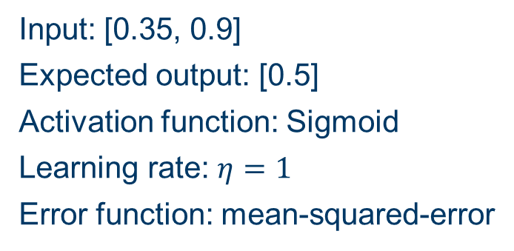

Backward propagation
Input: [0.35, 0.9]
Expected output: [0.5]
Activation function: Sigmoid
Learning rate: $η=1$
Error function: mean-squared-error
How should $w_{1}$ (at the hidden layer) be updated?
How much a change in $w_{1}$ affects the total error?
By chain rule
$$\frac{∂E}{∂w_{1}}=\frac{∂E}{∂o_{1}}×\frac{∂o_{1}}{∂{io}_{1}}×\frac{∂{io}_{1}}{∂h_{1}}×\frac{∂h_{1}}{∂{ih}_{1}}×\frac{∂{ih}_{1}}{∂w_{1}}$$
Input layer
Hidden layer
Output layer
$$i_{1}$$
$$h_{1}$$
$$w_{1}$$
Input 1
0.35
0.0991
0.68
$$w_{5}$$
$$w_{2}$$
0.2724
$$o_{1}$$
0.4
$$w_{3}$$
0.69
Output
$$i_{2}$$
0.8
$$h_{2}$$
Input 2
$$w_{4}$$
$$w_{6}$$
0.9
0.6637
0.8731
0.6
${Δw_{1}=η\frac{∂E}{∂w_{1}}=ηδ}_{o}w_{1}h_{1}\left({1−h}_{1}\right)$ $i_{1}=1×0.19×0.2139×0.3×0.68×\left(1−0.68\right)×0.35=9.286×{10}^{−4}$
$$updated w_{1}=w_{1}−∆w_{1}=0.1−9.286×{10}^{−4}=0.0991$$

Slide 13





Backward propagation
Input: [0.35, 0.9]
Expected output: [0.5]
Activation function: Sigmoid
Learning rate: $η=1$
Error function: mean-squared-error
How should $w_{1}$ (at the hidden layer) be updated?
How much a change in $w_{1}$ affects the total error?
By chain rule
$$\frac{∂E}{∂w_{1}}=\frac{∂E}{∂o_{1}}×\frac{∂o_{1}}{∂{io}_{1}}×\frac{∂{io}_{1}}{∂h_{1}}×\frac{∂h_{1}}{∂{ih}_{1}}×\frac{∂{ih}_{1}}{∂w_{1}}$$
Input layer
Hidden layer
Output layer
$$i_{1}$$
$$h_{1}$$
$$w_{1}$$
Input 1
0.35
0.0991
0.68
$$w_{5}$$
$$w_{2}$$
0.2724
$$o_{1}$$
0.3971
$$w_{3}$$
0.69
Output
Symbol notes:
$i$: values in input neurons
$io$: inputs to output neurons
$o$: outputs from output neurons
$ih$: inputs to hidden neurons
$h$: outputs from hidden neurons
$$i_{2}$$
0.7976
$$h_{2}$$
Input 2
$$w_{4}$$
$$w_{6}$$
0.9
0.6637
0.8731
0.5926
Similarly, for $w_{2}$, $w_{3}$ and $w_{4}$

Slide 14






Forward and backward propagation
Input: [0.35, 0.9]
Expected output: [0.5]
Activation function: Sigmoid
Learning rate: $η=1$
Error function: mean-squared-error
How should $w_{1}$ (at the hidden layer) be updated?
How much a change in $w_{1}$ affects the total error?
By chain rule
$$\frac{∂E}{∂w_{1}}=\frac{∂E}{∂o_{1}}×\frac{∂o_{1}}{∂{io}_{1}}×\frac{∂{io}_{1}}{∂h_{1}}×\frac{∂h_{1}}{∂{ih}_{1}}×\frac{∂{ih}_{1}}{∂w_{1}}$$
Input layer
Hidden layer
Output layer
$$i_{1}$$
$$h_{1}$$
$$w_{1}$$
Input 1
0.35
0.0991
0.68
$$w_{5}$$
$$w_{2}$$
0.2724
$$o_{1}$$
0.3971
$$w_{3}$$
0.682
Output
$$i_{2}$$
0.7976
$$h_{2}$$
Input 2
$$w_{4}$$
$$w_{6}$$
0.9
0.6637
0.8731
0.5926
With all wights updated, $o_{1}$ is now 0.682
$${E=\frac{1}{2}{{(o}_{1}−target)}^{2}=\frac{1}{2}(0.682−0.5)}^{2}=0.01656,$$
the previous E is $0.01805$.
More iterations.

Slide 15



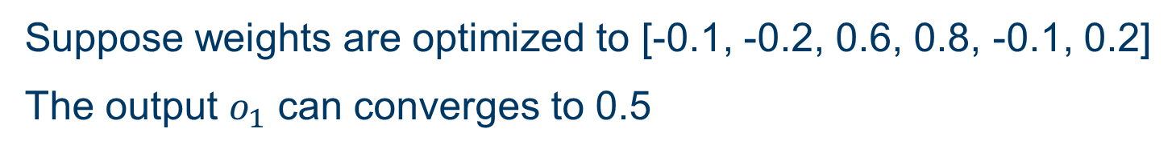


Prediction phase
Input layer
Hidden layer
Output layer
$$i_{1}$$
$$h_{1}$$
$$w_{1}$$
Input 1
0.35
-0.1
$$w_{5}$$
0.6236
-0.1
$$w_{2}$$
$$o_{1}$$
-0.2
$$w_{3}$$
0.5002
Output
$$i_{2}$$
0.6
$$h_{2}$$
Input 2
$$w_{4}$$
$$w_{6}$$
0.9
0.3122
0.2
-0.8
Suppose weights are optimized to [-0.1, -0.2, 0.6, 0.8, -0.1, 0.2]
The output $o_{1}$ can converges to 0.5

Slide 16




Thanks!
#UofGWorldChangers
@UofGlasgow

